Slide 1
Ski resort report
Xiao Yang

Slide 2
Problem identification
What is the projected profit increase for the Big Mountain Resort of a new pricing strategy (compared to its current premium pricing strategy), for year 2021? What is possible pricing strategy that can provide a return of investment of the facilities?

Slide 3
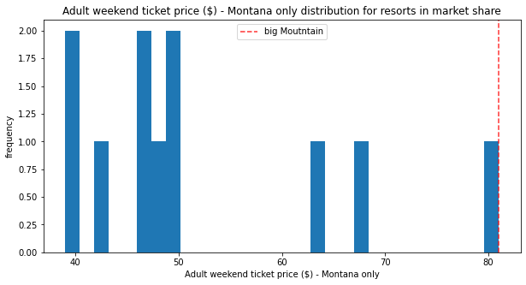
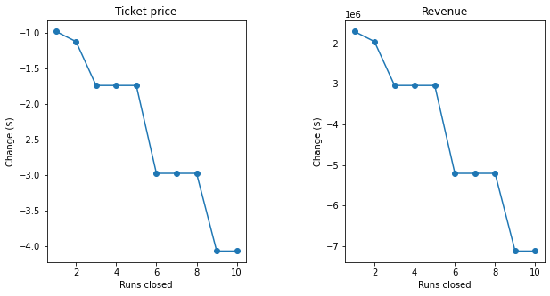
Recommendation and key findings
We recommend reducing 5 least used runs and adding 1 run for the following reasons
The ticket price of Big Mountain is already the highest among all the mountain resorts in Montana, so increasing ticket price will likely drive clients away when they compare prices about which resort to visit
Reducing 5 least used runs will reduce ticket price by $1.7, but saves maintenance cost for these runs
Adding 1 run with 150ft vertical drop will increase ticket price by $1.55
In total, the number of runs are reduced by 4, so the maintenance cost is reduced but the revenue will be kept almost the same

Slide 4
Modeling results and analysis
We modeled the ticket price based on the characteristics of the resorts, and analyzed 4 scenarios where we reduce runs, adding a run, increasing snow making area, and increasing the length of the longest run
What we found is that adding reducing 5 lease used runs will reduce ticket price by $1.7, and adding a run increase ticket price by $1.55, and the other two options do not change ticket price

Slide 5
Summary and conclusion
By building a predictive model of the ticket price based on resort characteristics, we recommend reducing 5 least used runs to reduce maintenance cost and add 1 new run with 150 ft vertical lift, so that the ticket price will be kept the same, but maintenance cost will be reduced – the overall net revenue is increased.

